Slide 1

Home Depot Canada -Product and Service Offerings
Lisa Brown
National Account Manager
The Home Depot Canada
Lisa_x_brown@homedepot.com
416 677 2227

Slide 2




The Home Depot | Product and Service Offerings
Home Depot Pro
Supporting our customers through Pro Direct Programs, an unlimited access to product and end-to-end business solutions
Save More on Every Job, Every Day
With our Bulk Pricing program, you get the quantities you need at prices you can count on everyday. Get 10%-25% off of the building materials you need to complete your job.
B2B
Personal Home page that allows you to track spend up to 2 years , view recent orders , buy again feature , access to all shipping information for multiple sites and more.
Member Rewards
Quarterly rewards on Qualifying Purchases (issued quarterly).Upon registration to the Program, each member will get a Pro Xtra ID and must use their Pro Xtra ID when shopping with The Home Depot to earn their Quarterly reward . Pay anyway Visa, AMEX,MC, Home Depot Credit , cash , cheque or debit

Slide 3
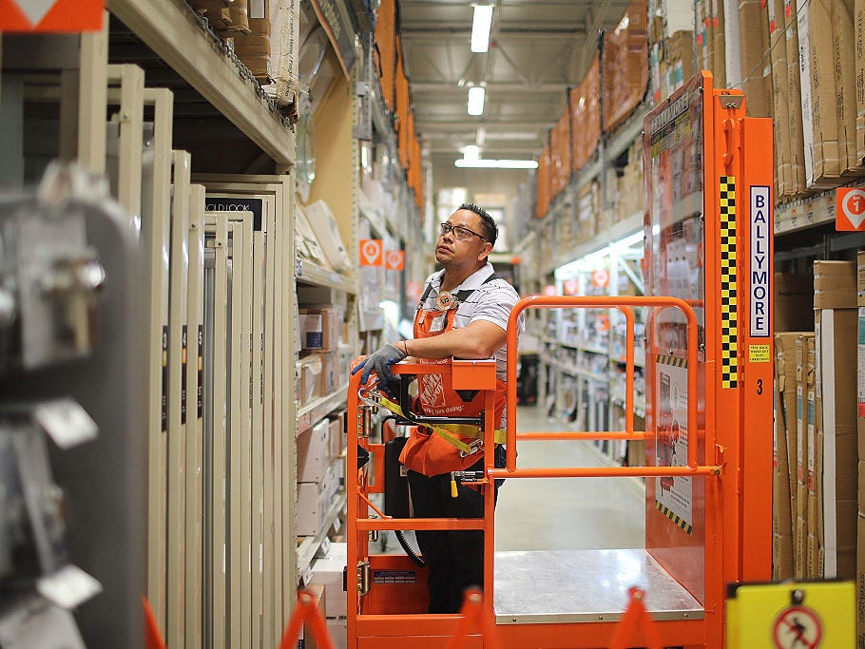
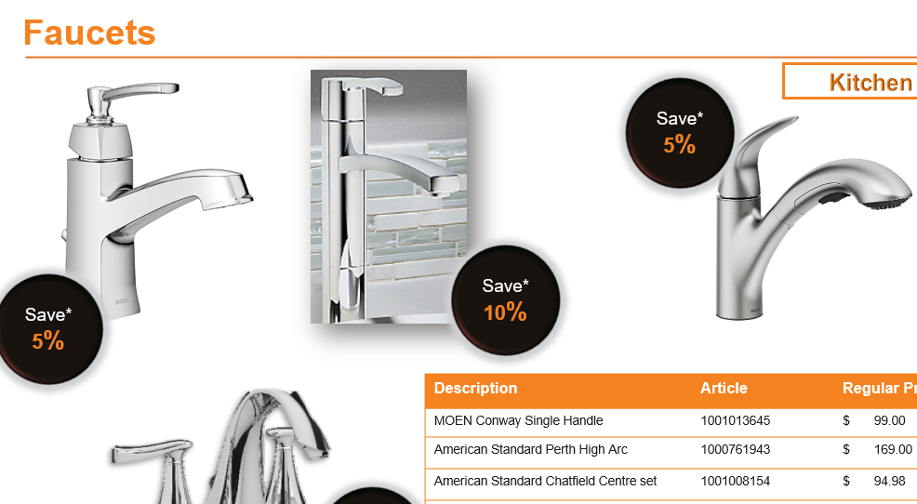
Sales Support | Supporting you through Commercial Team
Order Fulfillment Process
We do the work to save YOU Time and Money
Product order form received
Track completion
Inquiry Received
Recommend & Develop Product Assortment
Process Sale
Co-ordinate Delivery

Slide 4




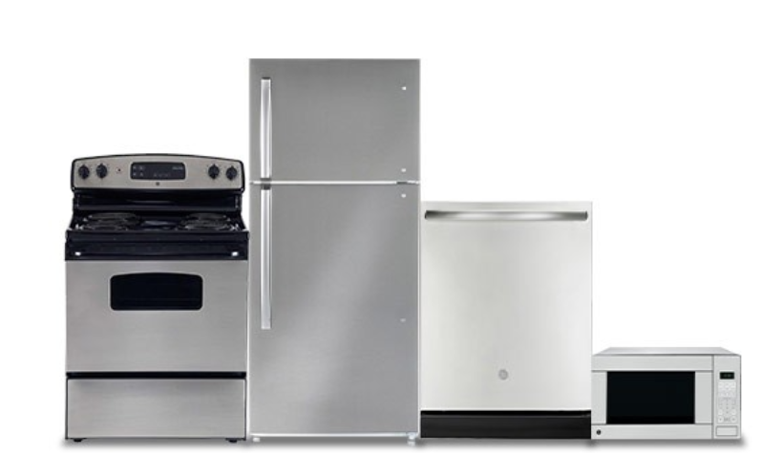
Bulk and Volume Programs | Save Time and Money
Member Projects and Product Assortment
Light Bulbs
HD Decorating
Power tools
Appliances

Slide 5
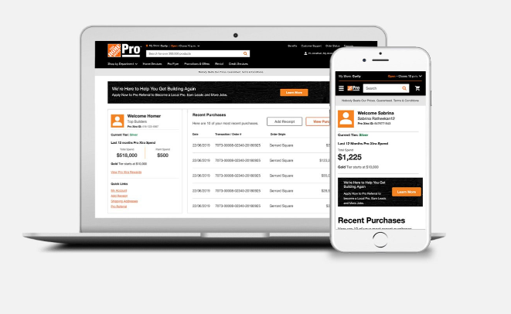
Pro Xtra | Pro Business Account
As a valued member of The Home Depot’s Pro Xtra Program, we’re excited to share with you the beginning of a truly personalized online experience for your business, making it easier to manage the day-to-day purchases made online or in-store.
This is a truly customized experience based on your industry type, shopping trends and more!
What are the benefits of a Pro Business Account?
Purchase Tracking , View and manage your purchases
Easily re-order the products you buy most
Quarterly Rewards on Qualifying Purchases and Qualifying Paint Purchases
Shop our extended assortment
PLUS, download The Home Depot Mobile App and get these benefits on-the-go!

Slide 6

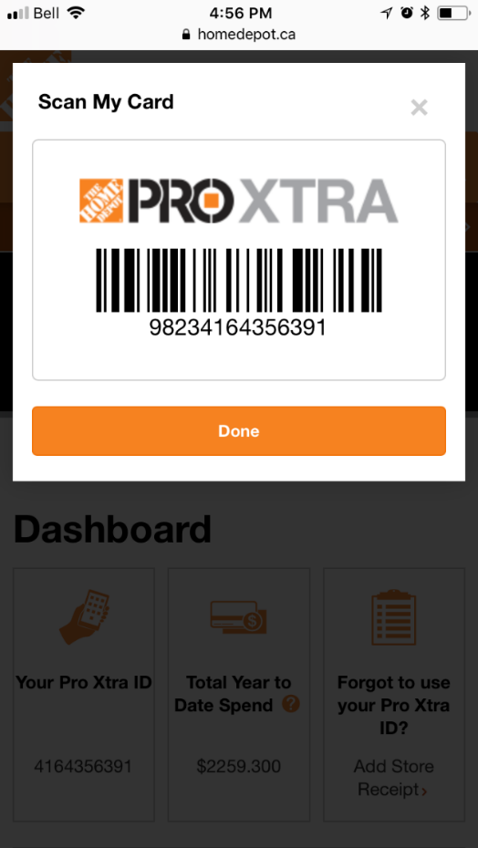

Pro Xtra ID | How it works
What is a Pro Xtra ID?
Your Pro Xtra ID is the phone number you registered for the program with
It’s a 10-digit identifier that you should be able to easily recall
It is unique to you
Why is my Pro Xtra ID so important?
Your Pro Xtra rebate is calculated based on purchases made with your Pro Xtra ID
You will now earn any way you pay, as long as you use your Pro Xtra ID to make Qualifying Purchases
What about shopping online?
Log into your Pro Xtra Account on homedepot.ca before you shop online. If you forget to login, call our support center and they will add those purchases to your account.
https://www.homedepot.ca/en/home/pro.html

Slide 7
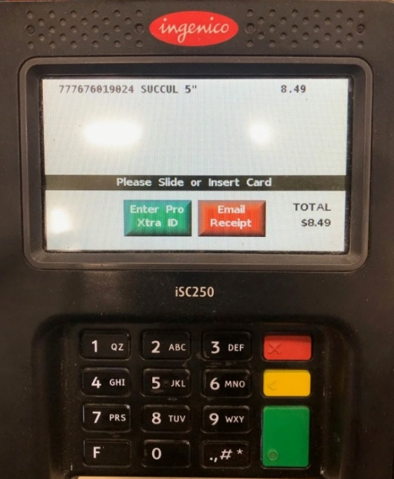
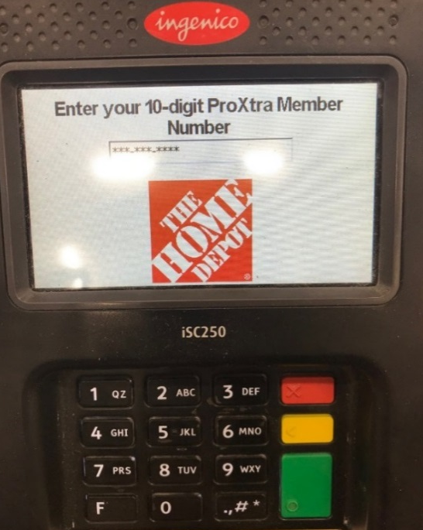
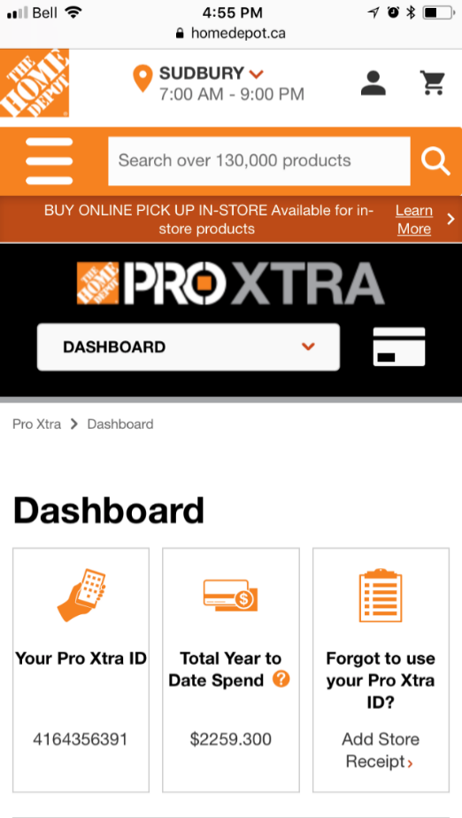


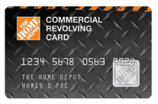
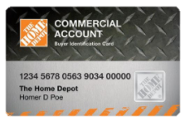
Pro Xtra ID | at Check out
1
KEY-IN PRO XTRA ID AT CHECK OUT
REMEMBER: It’s the phone number used
when registering for Pro Xtra
2
SCAN PRO XTRA ID DIGITAL BARCODE AT CHECK OUT
Available on homedepot.ca or The Home Depot App
“Enter Pro Xtra ID”
### - ### - ####
3
USE HOME DEPOT COMMERCIAL CREDIT CARDLINKED TO
A PRO XTRA ACCOUNT
Notes:
there are three ways to use your pro Xtra ID in stores the first is when you are checking out you can select enter your pro extra ID and input your 10 digit phone number Alternatively you can scan your pro extra ID barcode when you are checking out you can access this through the app by logging into your account or you can go to homedepot.ca log into your account and click on the ID icon which will pop up your pro Xtra ID which can be scanned finally if you have a Home Depot commercial credit card that is linked to your pro extra account you can use that if the credit card is linked you automatically will get rewarded on all your purchases you don't need to Additionally scan or type in your pro extra ID when you are checking out

Slide 8
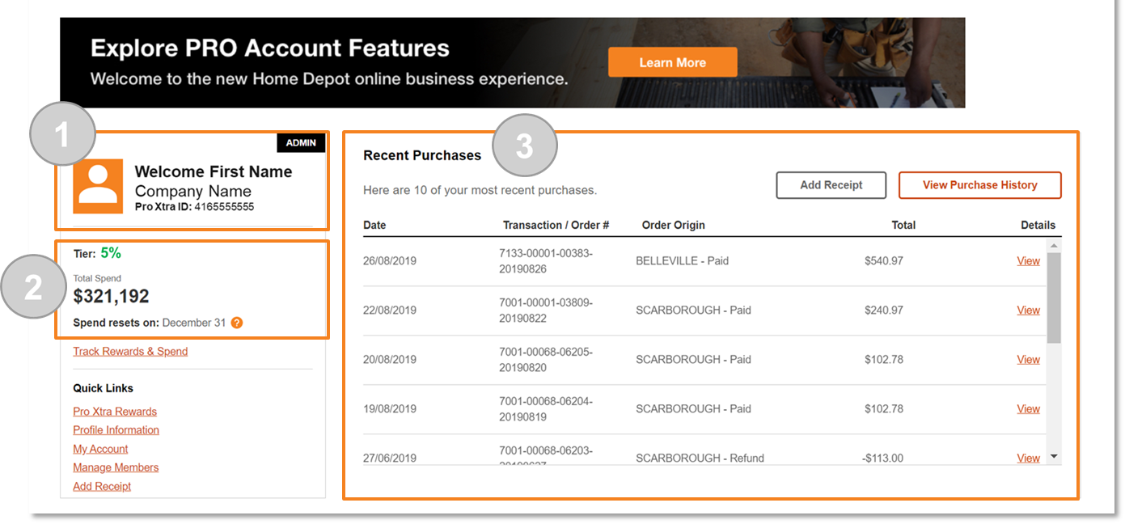
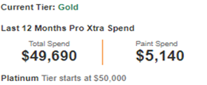
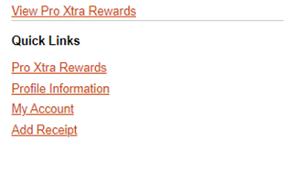
Pro Xtra member | B2B tracking - online Account
Your personalized Home Page is the hub to view your most recent activity with The Home Depot.
It includes:
1
Your Personal and Company Information
Your Pro Xtra ID
1
3
Membe
2
Your current Reward Tier
Your Total Spend – this is your Company’s total spend in the last 12 months
Your Paint Spend – this is your Company’s total spend on Qualifying Paint products in the last 12 months. It is a sub-set of your Total Spend
2
3
Recent Purchases – Shows the last 10 online or in-store purchases made with your Pro Xtra ID

Slide 9
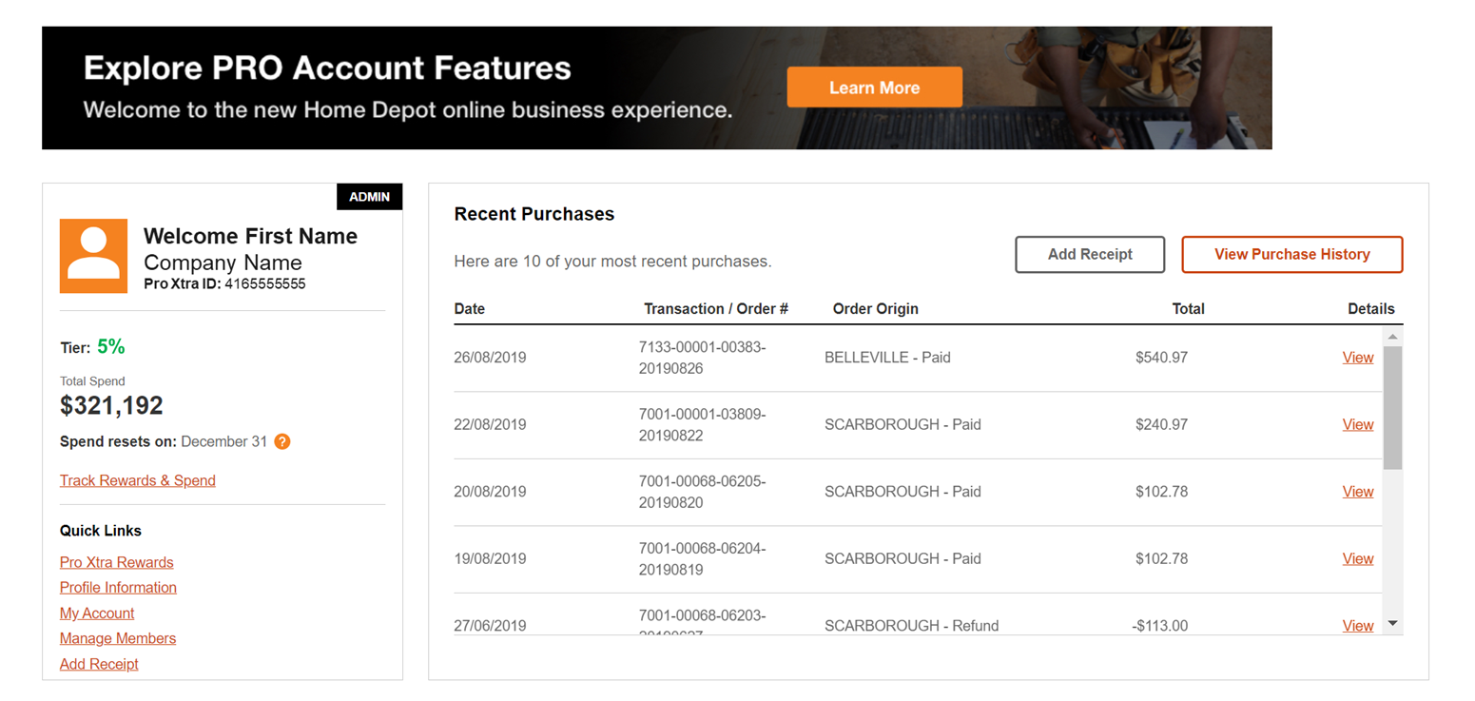
Pro B2B Online Account | Home Page continued…
Your personalized Home Page also includes:
4
Quick links to view your Pro Xtra Rewards & Spend along with other information about your Account
6
Member
5
5
Your ability to Add Receipts where you or your authorized buyers did not use a Pro Xtra ID when making a purchase for your business*
*Add Receipt function can be used for in-store transactions only. You must log in before you check out in order to get rewarded for online purchases.
4
6
Your Purchase History shows you detailed transaction records made with a Pro Xtra ID up to 2 years back

Slide 10
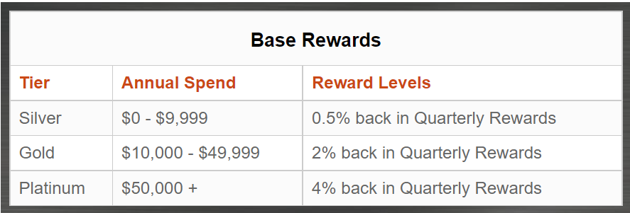

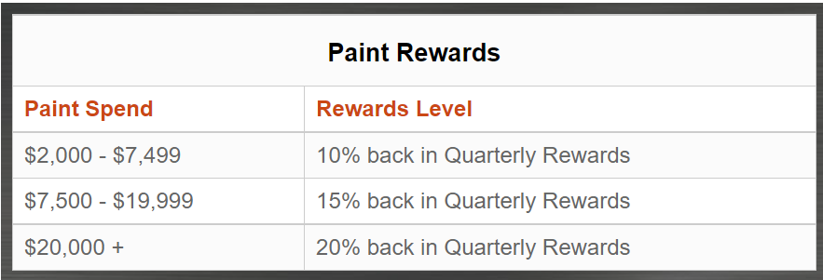
Pro Xtra | Reward Structure
**Minimum spend of $2K on qualifying paint purchases required to unlock the 10% Pro Paint Benefit – otherwise those transactions will be bonused at your Base Tier rate**

Slide 11
Pay Out Structure | Quarterly Rewards
Rewards are paid out to customers every 3 months (in May, August, November and February). The amount on the reward is based on how much a member has spent in the previous 3 months and what tier level they are earning at.
The more you spend, the more you’ll earn towards your Quarterly Rebate.
Quarterly Reward Payout Periods
To get rewarded, Pro Xtra member’s must:
Be a member of Pro Xtra
Use their Pro Xtra ID when shopping or add their receipt to their account after they make a purchase.
Add receipt within payout period.
Notes:
As a pro extra member you get rewarded four times a year
the currency of the pro extra program is gift cards. in February may August and November you will receive a payout for how much you earn that quarter
the payout that you receive depends on how much you spent and the tear that you fall into
you can either often to physical gift cards or you can opt into electronic gift cards
to get rewarded you must be a member so any purchases you made prior to becoming a pro extra member won't be bonused on you must use your pro extra ID when you're shopping or you need to add the receipt after you make a purchase if you didn't use your pro extra ID to your account so you can get rewarded for that purchase
and finally you need to add the receipt within that quarter
For example if it if it if you made a purchase in February you must add the receipt to your account between February 1st and April 30th to get rewarded for that purchase if you do not add your receipt during that. But you added after let's say sometime in may or June you won't get gift card reward for that purchase but that amount will be added to your total annual spend and as a reminder your total annual spend is what dictates the reward tier that you fall into so it's always worth adding in that receipt even if it's outside of the quarter because that might move you from a silver to a gold tier member or gold to platinum to your member and ultimately the tier that you fall into will determine the percentage back that you were receiving in gift cards

Slide 12
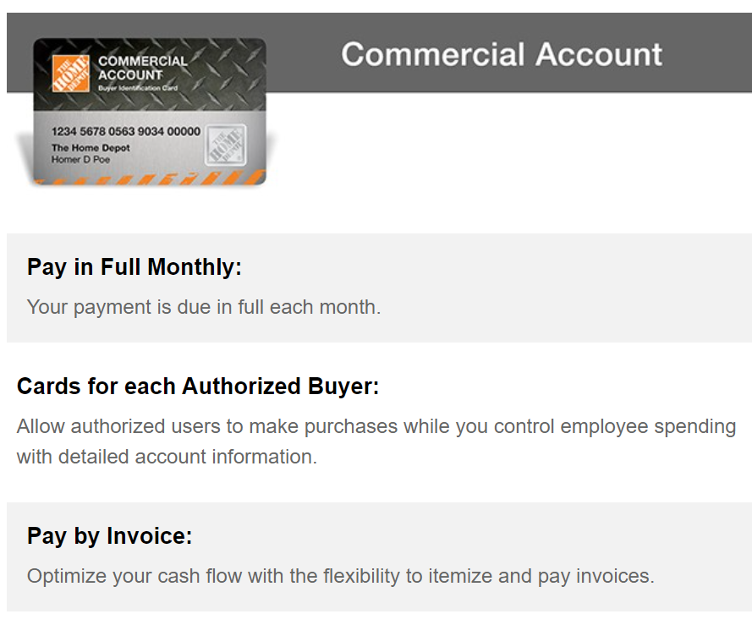
Home Depot | Commercial Invoice Account
Business Name
Authorized Buyer 1
Authorized Buyer 2
Authorized Buyer 3
https://www.homedepot.ca/en/home/credit-services.html#CommercialAccount

Slide 13
Pro Xtra | Links and Contact
B2B video
https://vimeo.com/460226417
Pro Xtra Base Rewards
https://www.homedepot.ca/en/home/pro/proxtra.html
Pro Xtra Paint Rewards
https://www.homedepot.ca/en/home/pro/proxtra/pro-paint-rewards.html
Pro Xtra Terms and Conditions
https://www.homedepot.ca/en/home/pro/proxtra/terms-and-conditions.html
FAQ
https://www.homedepot.ca/en/home/pro/proxtra/frequently-asked-questions.html
Lisa Brown
National Account Manager
The Home Depot Canada
Lisa_x_brown@homedepot.com
416 677 2227

